Slide 1
STUDENT MANAGEMENT SYSTEM
Presented by
Tejashwini Sammeta.
Batch: 2021-6768
Under the guidance of,
Pooja Mehta

Slide 2
Introduction:
The student management system is an environment where all the process of the student in the institution is managed. It is done through the automated computerized method.
The records includes student Names, ID’s , Courses , Fee details.
The Student Management System is an automated version of manual student management system.
This also displays the status of the student which includes Student Name, ID, Courses Enrolled , Tuition fee ,Remaining Balance.

Slide 3
Language & platform:
Language : Core Java
IDE: Spring Tool Suite
Operating System: Windows

Slide 4
Functions
Student Name
Student ID
Courses Enrolled
Tuition Fee
Status

Slide 5
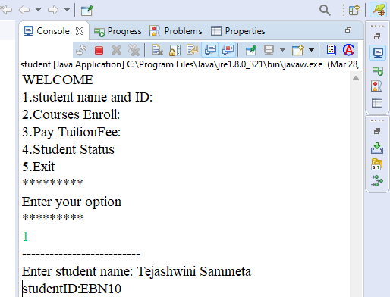
Project screenshots
Student Name
Student ID

Slide 6
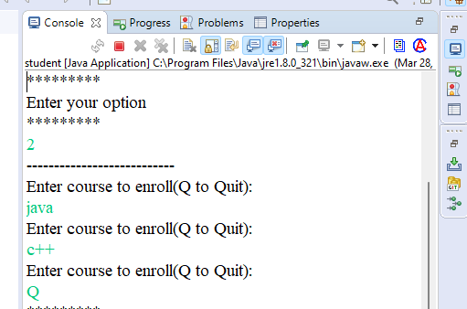
Courses enrolled

Slide 7
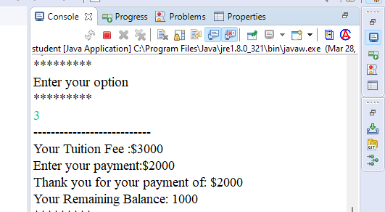
Tuition fee

Slide 8
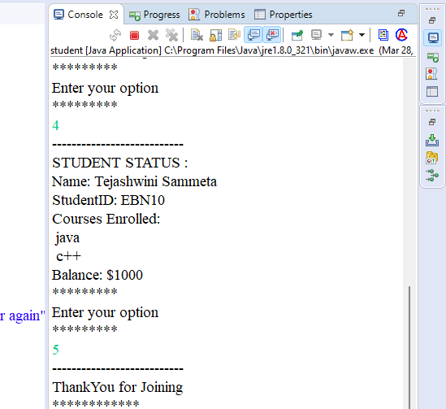
Student status

Slide 9
THANK YOU

